Slide 1
PatchAttack: A Black-box Texture-based Attack
with Reinforcement Learning
Chenglin Yang, Adam Kortylewski, Cihang Xie, Yinzhi Cao, Alan Yuille
CCVL, Johns Hopkins University

Slide 2
Patch-Attack: Summary
Digital Perturbation Attacks which are imperceptible can fool Deep Nets. But many of these attacks are white box, i.e. require knowing the weights of the Deep Net, and there are a growing number of effective defenses.
We develop a black box texture-based attack which requires no knowledge of the Deep Net. Our method learns an attack policy which selects texture-patches from a pre-defined dictionary.
We show that we can successfully attack a range of Deep Nets for classification and reducing their effectiveness by up to 90% using only small patches.
The attack is resistant to existing defenses.
Chenglin Wang, Adam Kortylewski, Cihang Xie, Yinzhi Cao, Alan Yuille. “PatchAttack: A Black-box Texture-based Attack with Reinforcement Learning”. ECCV. In review. 2020.

Slide 3
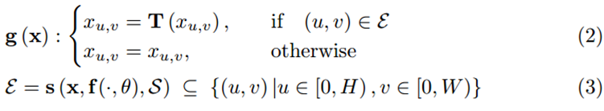
Texture-Patch Attacks
Use Reinforcement Learning to learn a policy which, for each image, selects texture-patches and places them in the image so as to:
Optimize the position and scale of the patch(es)
Optimize the texture-pattern of the patch(es)
Mathematical Formulation:

Slide 4
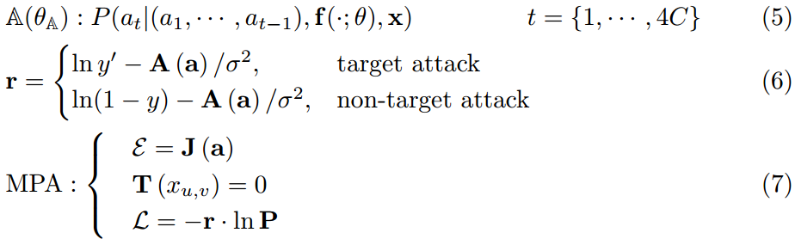
PatchAttack: MPA
Patch Search with Reinforcement Learning:

Slide 5


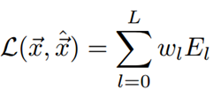
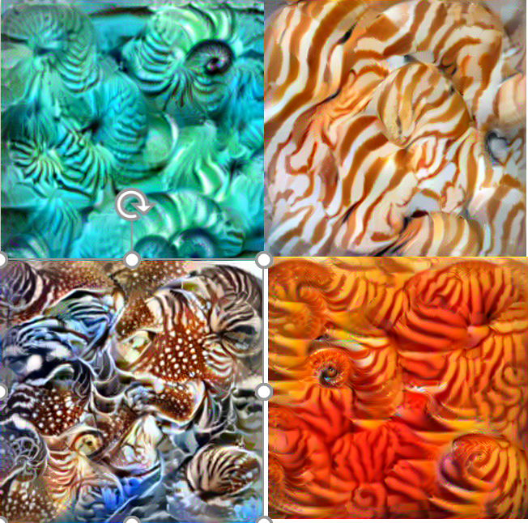
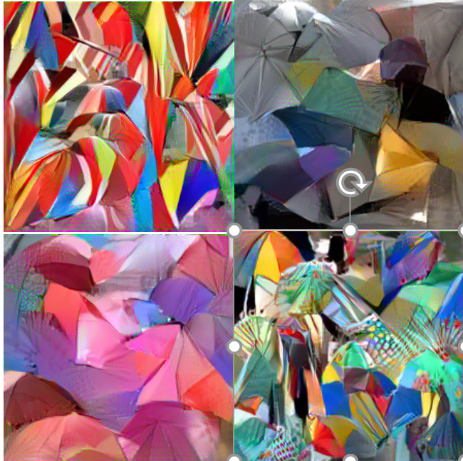
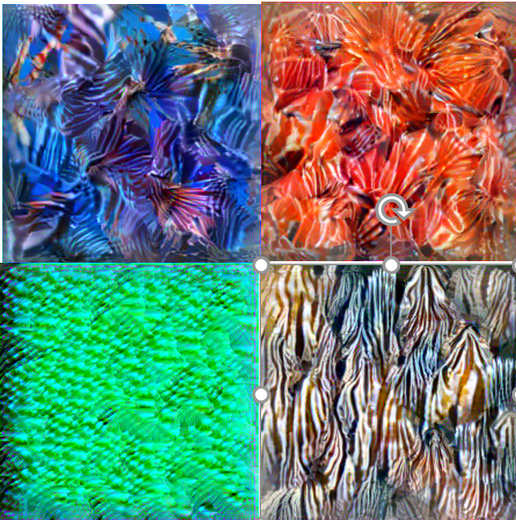
Two types of Textures
(1). Monochrome Patch Attack (MPA):
(2). Texture-Based Patch Attack (TPA):
Texture Patches are learnt from a surrogate Deep Net (using GramMatrices).
Nautilus. Umbrella. Lionfish.

Slide 6
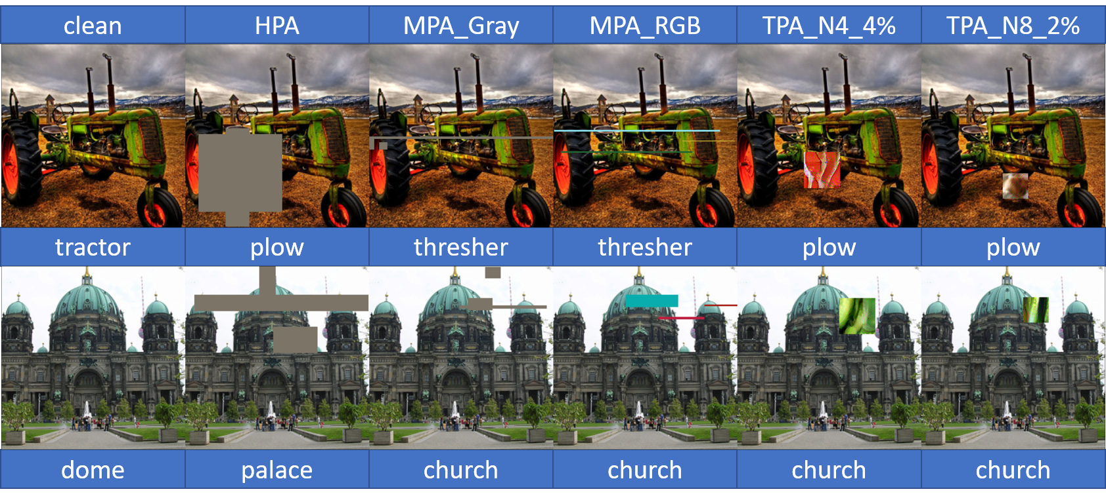
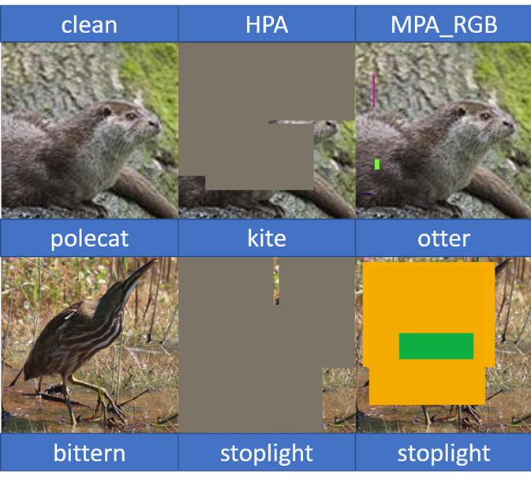
MPA: small patches confuse similar object classes.

Slide 7
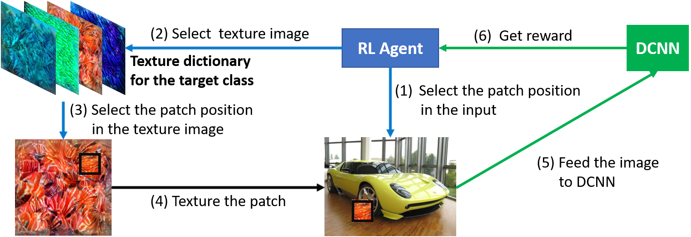
PatchAttack: TPA

Slide 8
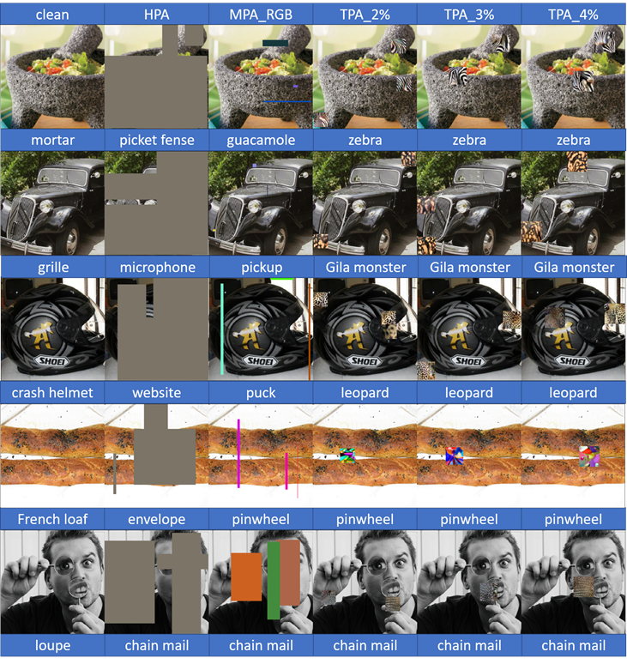
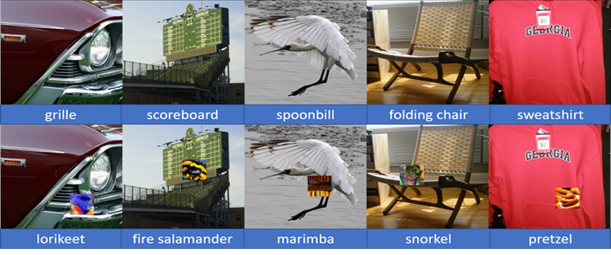
PatchAttack: TPA can confuse very different classes
Here are examples.

Slide 9
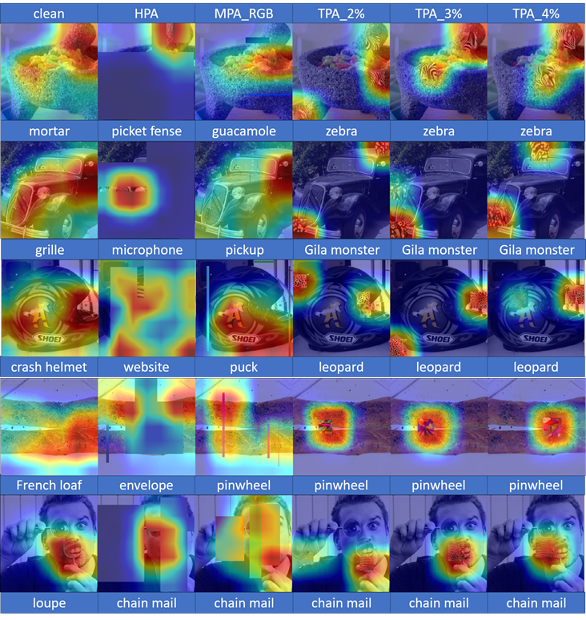
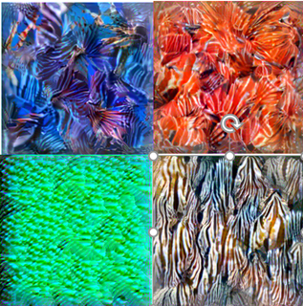
Intuition: Why Do Patch-Attacks Work?
The Deep Net has an internal attention mechanism (buried in the weights). The Patch-Attack highjacks the attention mechanism so that it focuses on the patch. The Deep Net thinks the patch looks more like an object than the object itself.
This shows a major limitation of Deep Networks.
Recall that the texture-patches look like this:

Slide 10
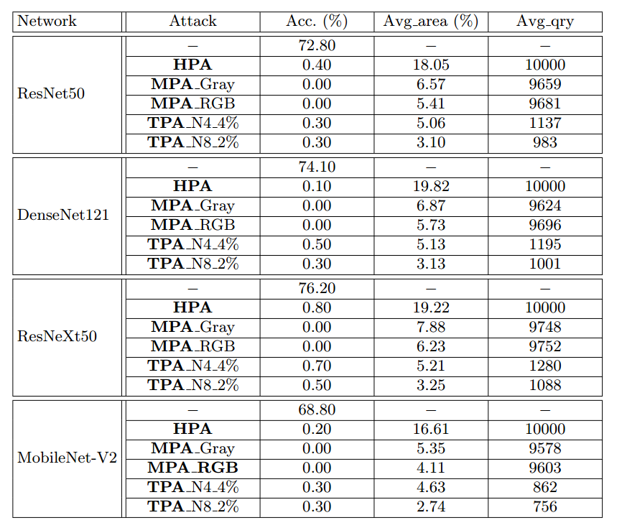
Experiments
Non-targeted Attack
1000 images randomly selected from the validation set of ImageNet

Slide 11
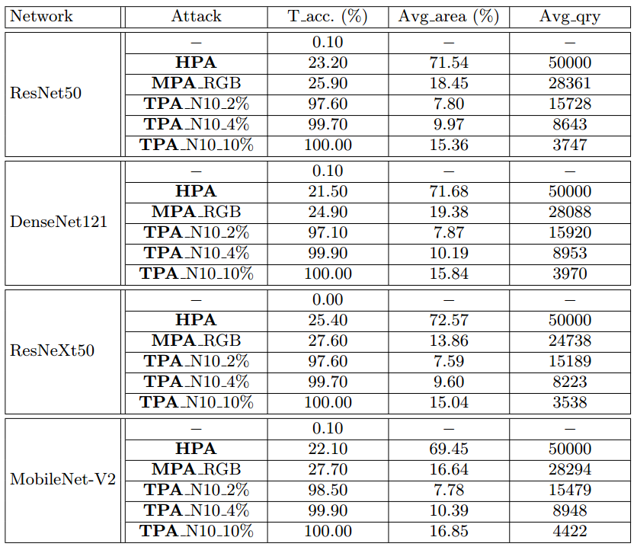
Experiments
Targeted Attack
1000 images randomly selected from the validation set of ImageNet
Target labels are randomly selected

Slide 12
Summary
We propose PatchAttack, a powerful black-box texture-based patch attack.
Show that even small textured patches are able to break deep networks
Monochrome Patch Attack achieves a strong performance on non-targeted attack, surpassing previous work by a large margin using less queries and smaller patch areas
Texture-based Patch Attack achieves exceptional performance in both targeted and non-targeted attacks
PatchAttack breaks traditional SOTA defenses and shape-based networks

Slide 13
The Bigger Picture
Simple Attacks and Patch Attacks are playing an adversarial game where the attacker tries to find the stimuli which causes the network to fail.
The simple attacks are small perturbations of the images found by differentiation.
Patch attacks are non-local and require a more complex search strategy to find them (e.g., reinforcement learning).
Conventional deep networks – CNNs or Transformers – are unable to defend against patch attacks. But compositional Models and VLMs can.
The deeper issue is that Deep Networks should be tested in an adversarial manner by searching for the stimuli that cause them to fail, instead of simply by average case over from samples randomly selected.

